Slide 1


A Microscopic View of Bursts, Buffer Contention, and Loss in Data Centers
Ehab Ghabashneh, Yimeng Zhao, Cristian Lumezanu, Neil Spring, Srikanth Sundaresan, Sanjay Rao

Slide 2
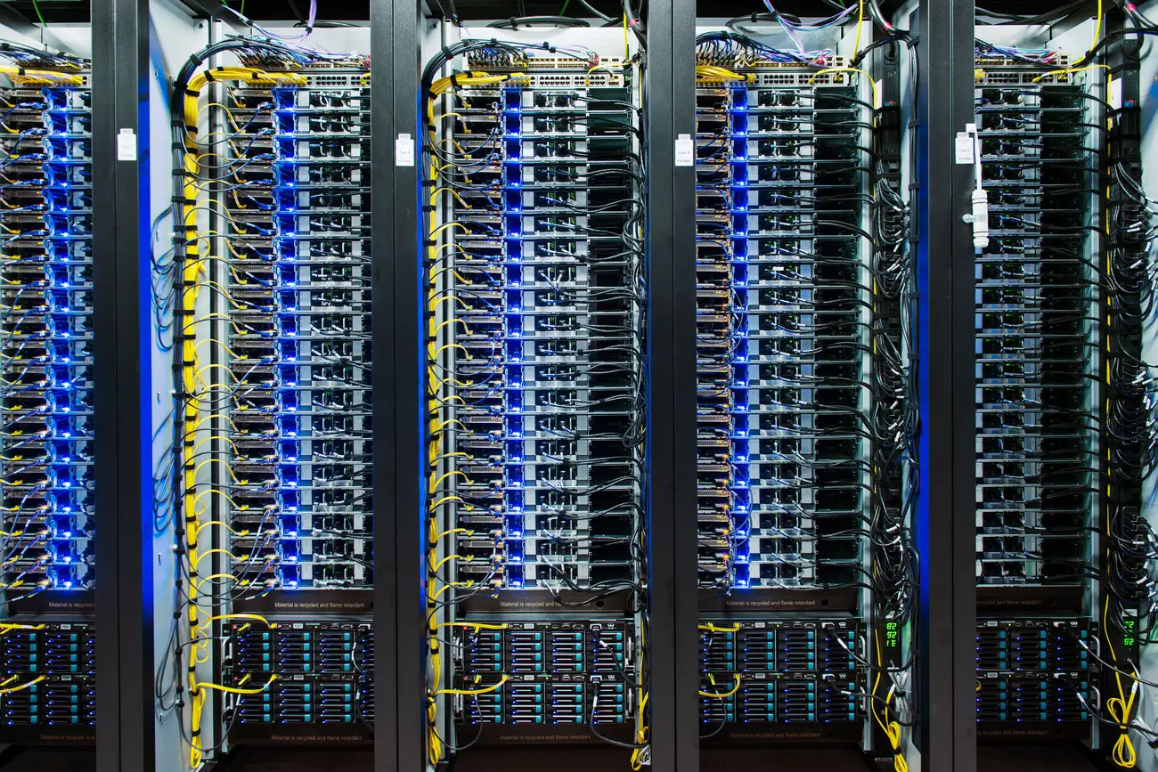
Introduction
Data center traffic patterns are crucial for network design tasks.
Data center traffic is bursty.
Bursts can collide on ToR switch. ASIC is dynamically shared. Thus, loss.

Slide 3
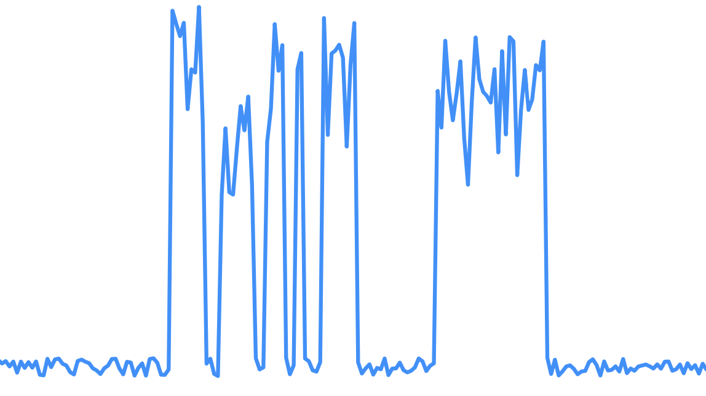

Introduction
Burst Threshold
100
Link Utilization (%)
50
This work aims to:
Characterize bursts
Burst Length
Burst Frequency
# of connections (incast level)
0
0
100
150
200
250
300
Time (ms)

Slide 4
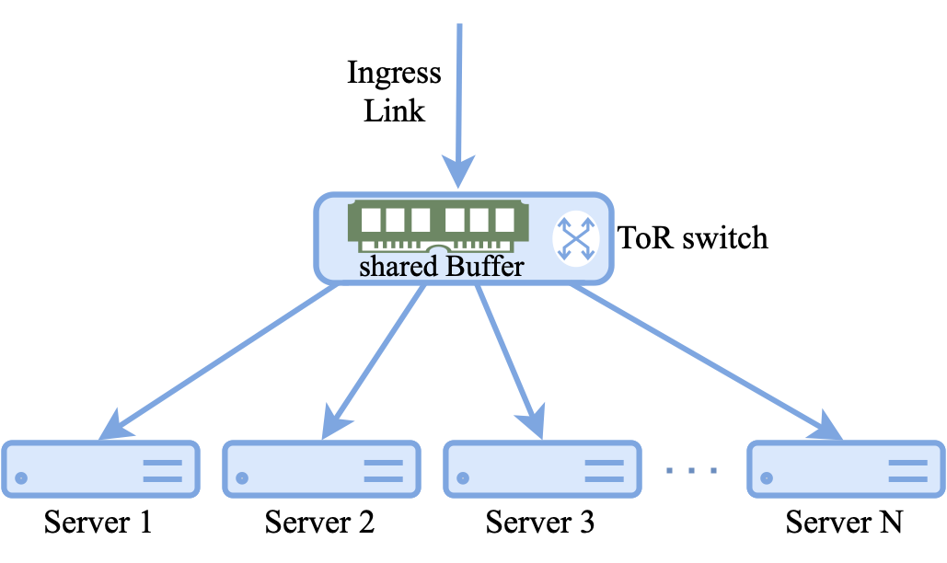
Introduction
Burst Threshold
100
Link Utilization (%)
50
This work aims to:
Characterize bursts
Burst Length
Burst Frequency
# of connections (incast level)
Characterize contention
0
0
100
150
200
250
300
Time (ms)

Slide 5
Introduction
Burst Threshold
100
Link Utilization (%)
50
This work aims to:
Characterize bursts
Burst Length
Burst Frequency
# of connections (incast level)
Characterize contention
Study how the interplay between burstiness and contention impacts loss
0
0
100
150
200
250
300
Time (ms)

Slide 6
Measurement Constraints
Low per-packet processing, to run at line rate
Low storage overhead, to keep history of all server-links
Programmable, deployable, and maintainable at scale

Slide 7
Switch-based monitoring is insufficient!
100
Link Utilization (%)
50
Existings traffic monitoring are switch-based.
Coarse grained [1-4]
0
0
5
10
15
20
25
Time (min)
¹He etal. “Understanding switch buffer utilization in CLOS data center fabric”. Buffer-workshop stanford 2019.
²Benson etal. “Network traffic characteristics of data centers in the wild”. SIGCOMM 2010.
³Kandula etal. “The nature of data center traffic: measurements & analysis”.SIGCOMM 2009.
⁴Roy etal. “Inside the social network’s (datacenter) network”. SIGCOMM 2015

Slide 8
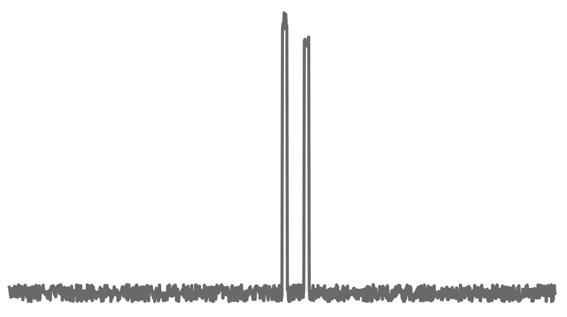
Switch-based monitoring is insufficient!
100
Link Utilization (%)
50
Existing traffic monitoring are switch-based.
Coarse grained [1-4]
Cannot correlate loss with link utilization
Fine grained [5]
0
0
5
10
15
20
25
Time (min)
100
Link Utilization (%)
50
0
0
400
800
1200
1600
2000
Time (ms)
¹He etal. “Understanding switch buffer utilization in CLOS data center fabric”. Buffer-workshop stanford 2019.
²Benson etal. “Network traffic characteristics of data centers in the wild”. SIGCOMM 2010.
³Kandula etal. “The nature of data center traffic: measurements & analysis”.SIGCOMM 2009.
⁴Roy etal. “Inside the social network’s (datacenter) network”. SIGCOMM 2015
⁵Zhang etal. “High-resolution measurement of data center microbursts”. IMC 2017.

Slide 9
Switch-based monitoring is insufficient!
100
Link Utilization (%)
50
Existing traffic monitoring are switch-based.
Coarse grained [1-4]
Cannot correlate loss with link utilization
Fine grained [5]
Cannot run on scale due to intensive overhead
0
0
5
10
15
20
25
Time (min)
100
Link Utilization (%)
50
0
0
400
800
1200
1600
2000
Time (ms)
¹He etal. “Understanding switch buffer utilization in CLOS data center fabric”. Buffer-workshop stanford 2019.
²Benson etal. “Network traffic characteristics of data centers in the wild”. SIGCOMM 2010.
³Kandula etal. “The nature of data center traffic: measurements & analysis”.SIGCOMM 2009.
⁴Roy etal. “Inside the social network’s (datacenter) network”. SIGCOMM 2015
⁵Zhang etal. “High-resolution measurement of data center microbursts”. IMC 2017.

Slide 10
Contributions
Millisampler lightweight network traffic characterization tool
Operates at fine, configurable time scales
Deployed at every host in our fleet
Instrumenting hosts allows for richer context
Host-centric large scale characterization of bursts, contention, and loss
91.4% of bursts experience contention
Drop in buffer share due to contention > 70% in some cases
Low contended racks experienced 2.9X higher loss than highly contended ones

Slide 11
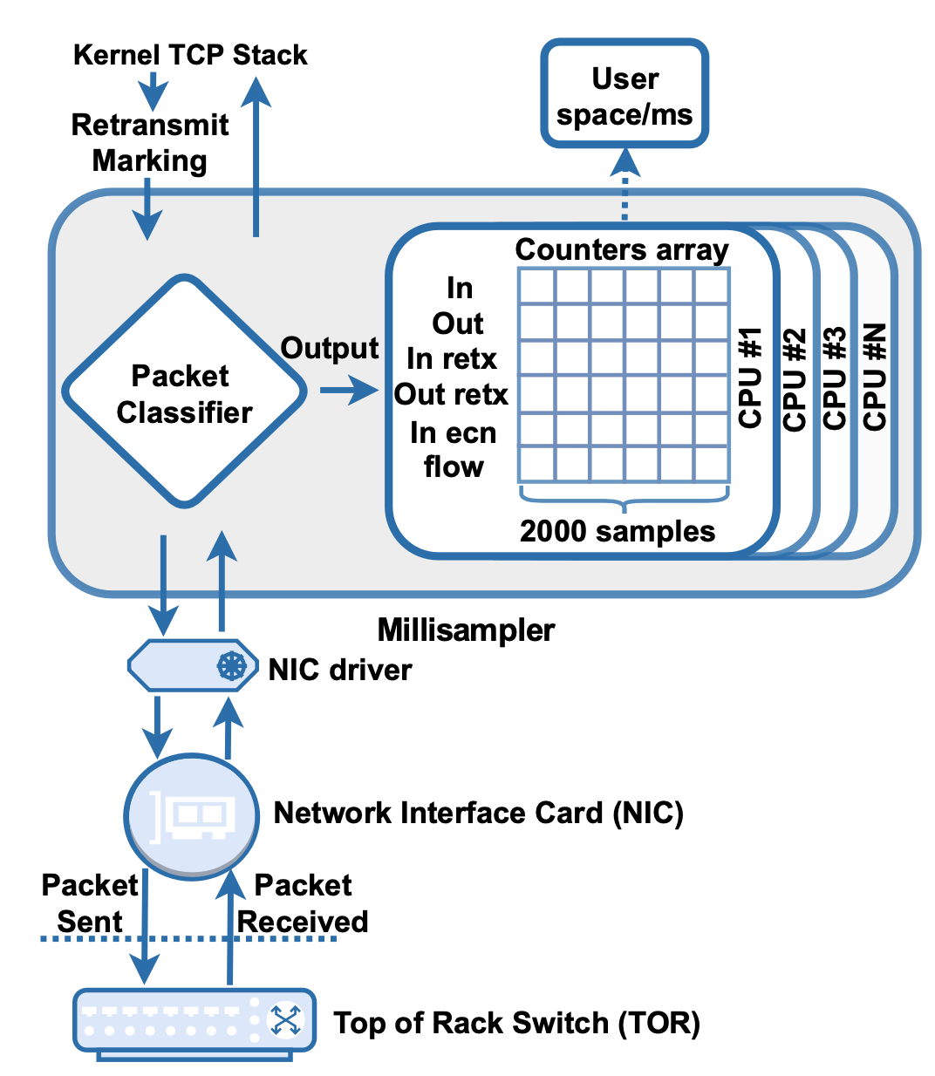
What is Millisampler?
Millisampler comprises user-space code to collect network info at fine granule time-scales.
Millisampler memory footprint comprises of 2000 64-bit counters per CPU core for each metric it tallies:
Ingress/Egress total and retx
Ingress ECN marked bytes
Number of active connections

Slide 12
SyncMillisampler for contention
For synchronized bursts across servers contending for ToR switch buffer, we developed SyncMillisampler.
SyncMillisampler has centralized control plane to schedule concurrent runs across servers in a rack.

Slide 13
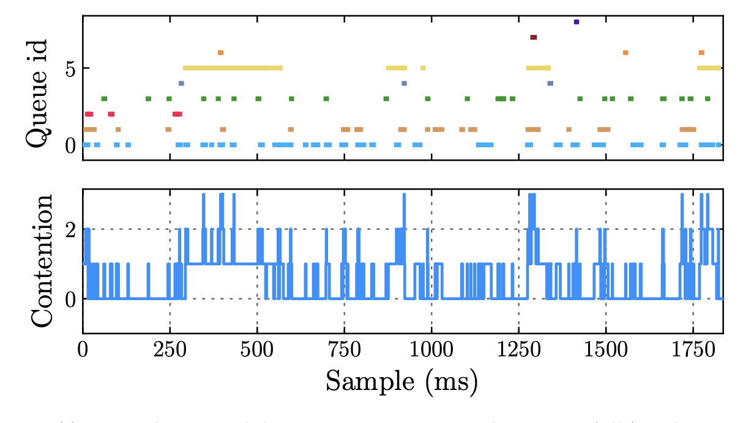
Snapshot of SyncMillisampler run

Slide 14
Large scale analysis of bursts, contention, and loss
Bursts Characterization
Contention Characterization
Bursts and contention correlation with loss

Slide 15
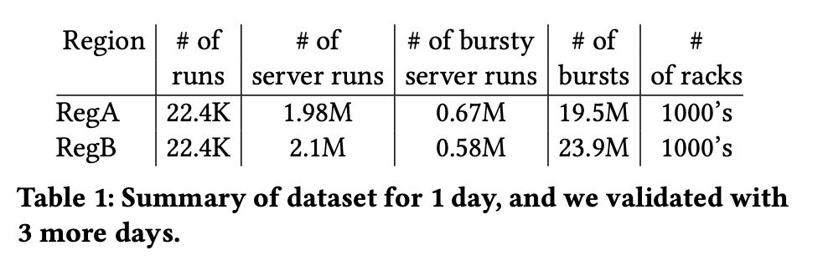
Dataset
Single weekday in 2022
Two Meta regions (regA and RegB)
Multiple data centers per region
1000’s of racks
Randomly select 1000 racks to sample, and repeat!
44.8K runs → 4.08M server-runs → 8.16B samples
Validated results from additional three weekdays

Slide 16
Large scale analysis of bursts, contention, and loss
Bursts Characterization
Burst are frequent. Median run experience 7.5 bursts/sec
Bursts are short. Median burst length is 1-2 ms
The number of active connections is 2.7X higher during burst
Contention Characterization
Bursts and contention correlation with loss

Slide 17
Large scale analysis of bursts, contention, and loss
Bursts Characterization
Contention Characterization
Bursts and contention correlation with loss

Slide 18
How buffer is shared across servers?
⍺ is a knop
ToR Switch uses dynamic threshold (DT) algorithm for sharing buffer across all servers.
Balance competing goals of avoiding loss and fairness.

Slide 19
Contention Characterization: Motivation
What is the degree of contention in data center racks? How does contention vary across racks ?
How does contention vary within a rack across timescales ranging from milliseconds to an entire day?

Slide 20
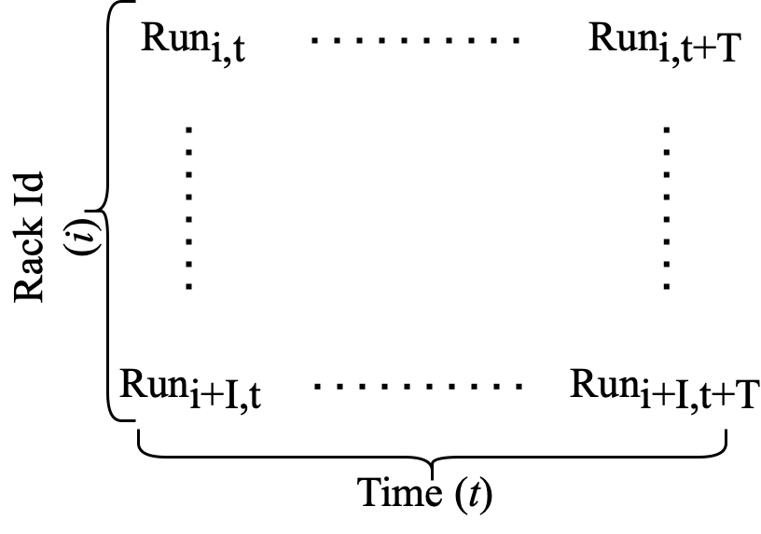
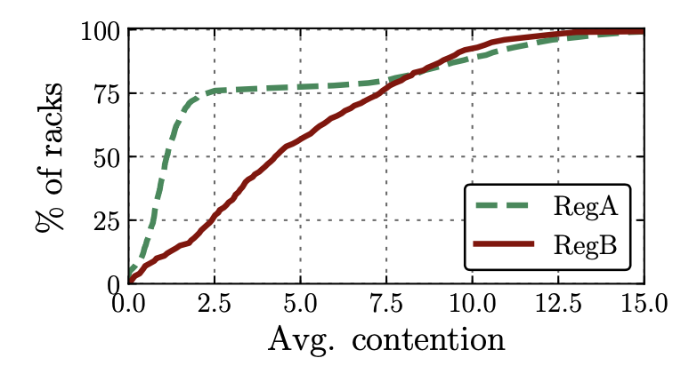
How contention looks across racks ?
Busy Hour
Racks average contention follows different distribution per region
RegA is bimodal
RegB is uniform
Yet, similar spread of average contention
Average

Slide 21
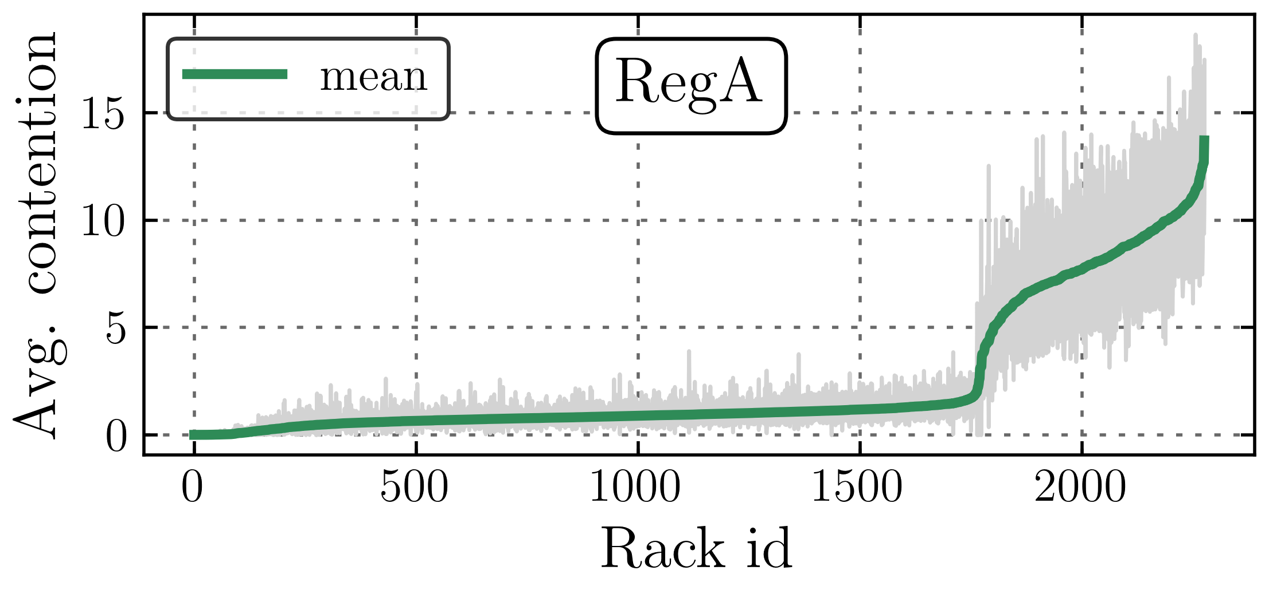
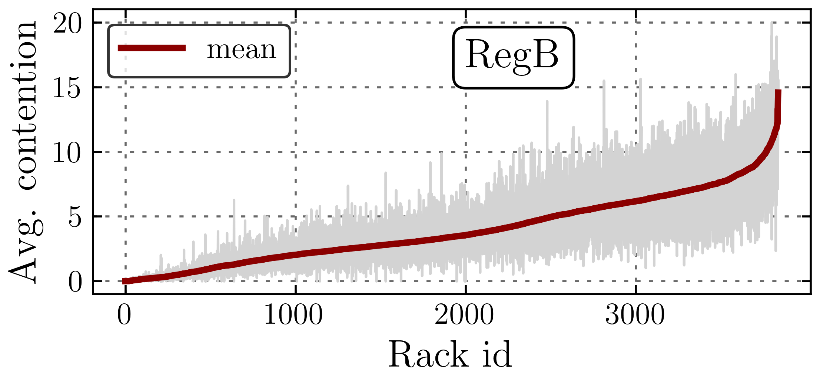
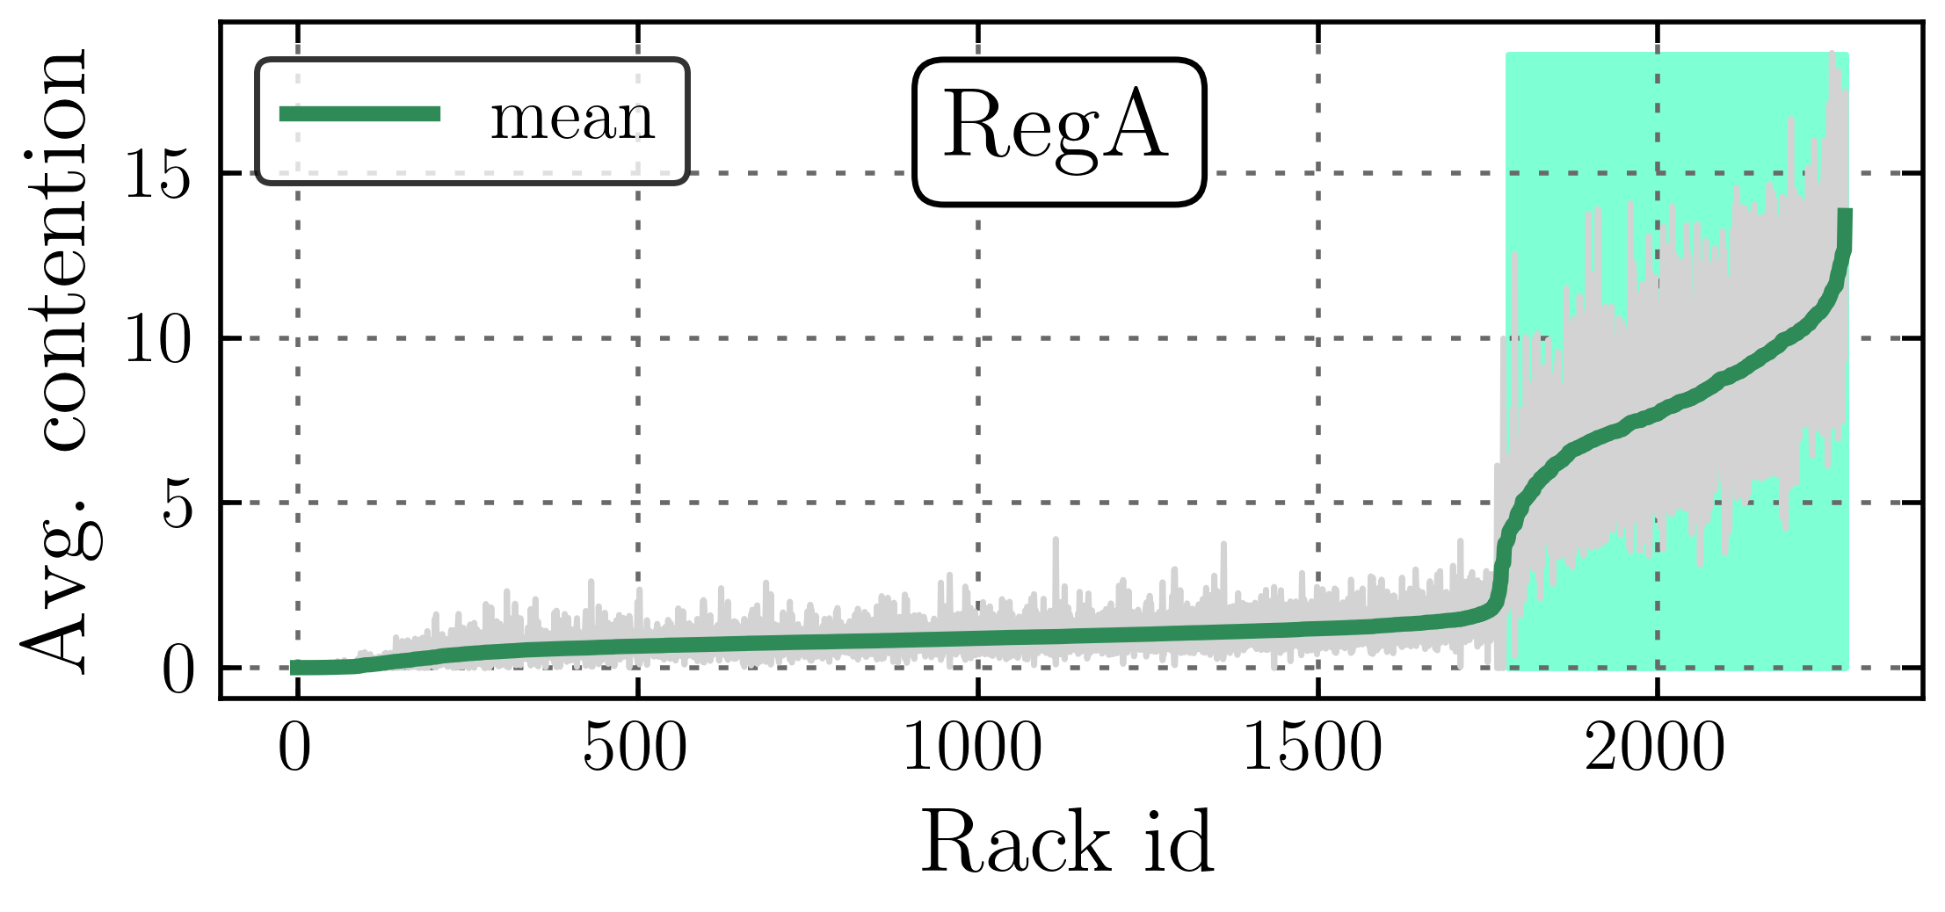
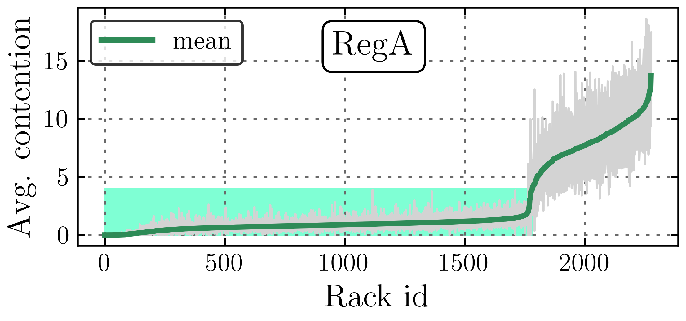
Does contention vary across the day?
avg per run → (mean, min, and max)
Highly contended racks
Always highly contended
Low contended racks
Low contention variation.
Increase ⍺ ?

Slide 22
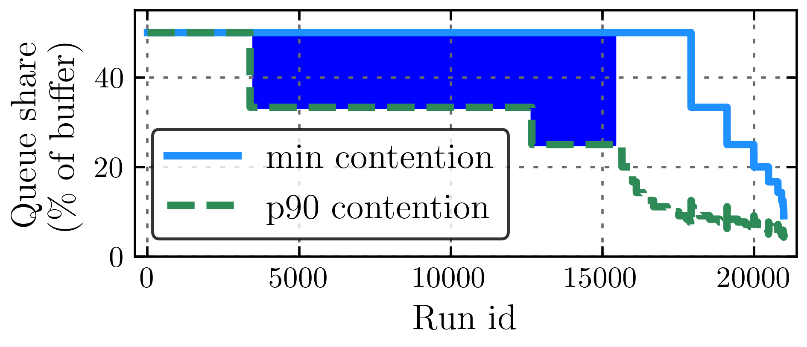
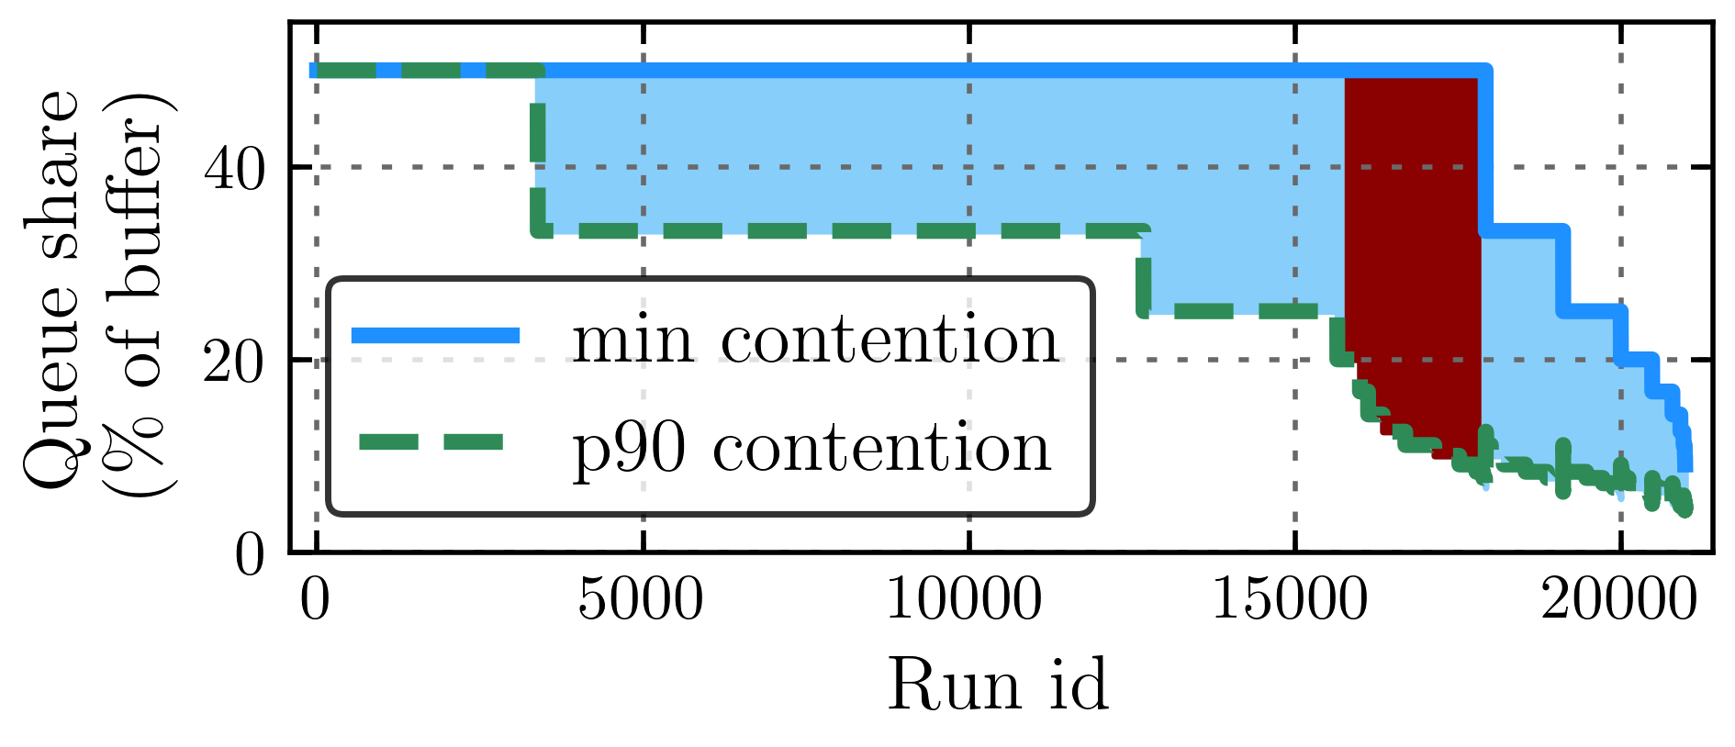
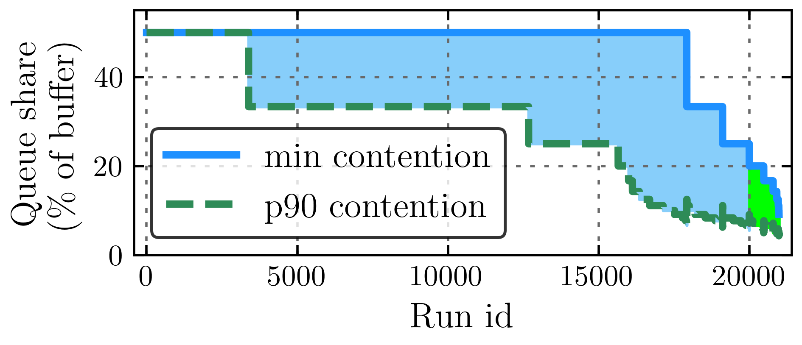
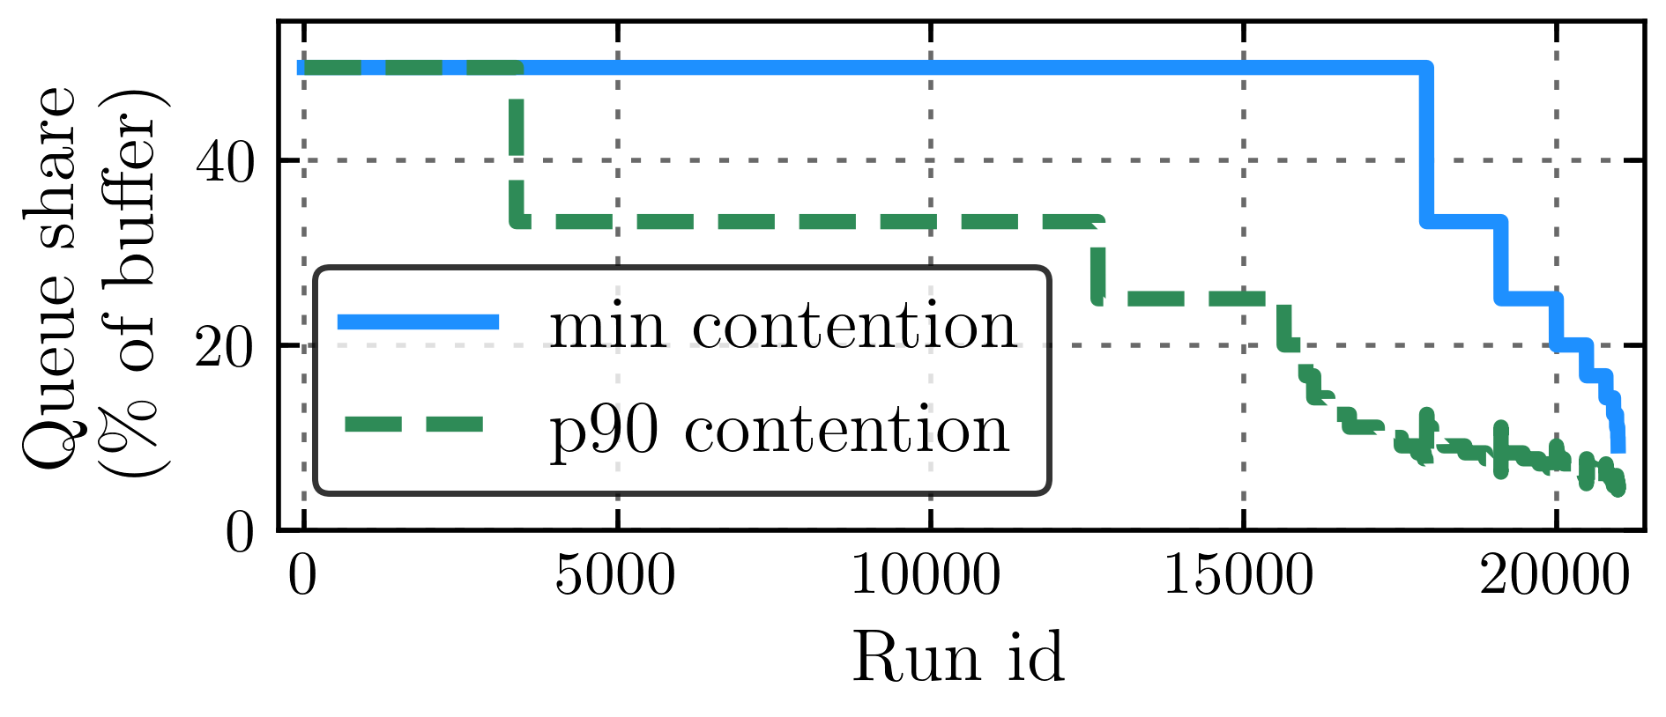
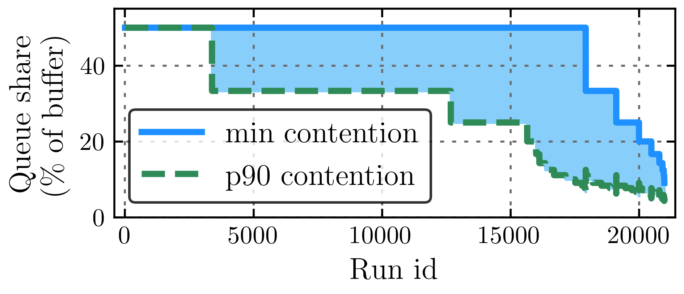
Contention variation within the run: RegA
Drop in buffer
share >= 70%
22.4K rack runs
Drop in buffer share
High contended runs.
Small yet stable buffer share.
Low contended runs. Small change in contention → huge drop in buffer share

Slide 23
Contention interplay with task placement
60% to 100% of servers in the highly contended racks run the same task
The task placement algorithm favored co-locating ML workloads densely in a single rack
Low contended racks are more tasks diversified. Only 25% of servers in median rack run the same task

Slide 24
Large scale analysis of bursts, contention, and loss
Bursts Characterization
Contention Characterization
Bursts and contention correlation with loss

Slide 25
Contention, Bursts, and Loss: Motivation
How does contention impact losses?
How do burst properties interplay with contention impact losses?

Slide 26
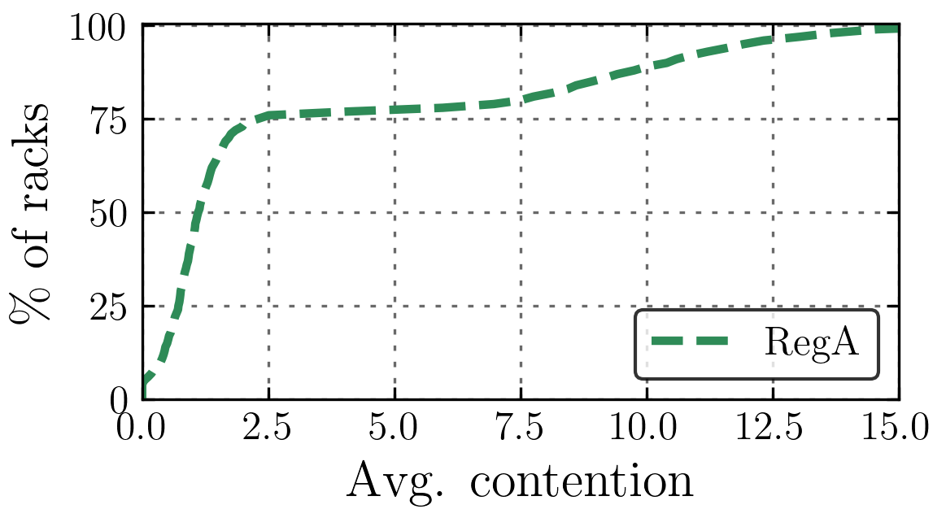
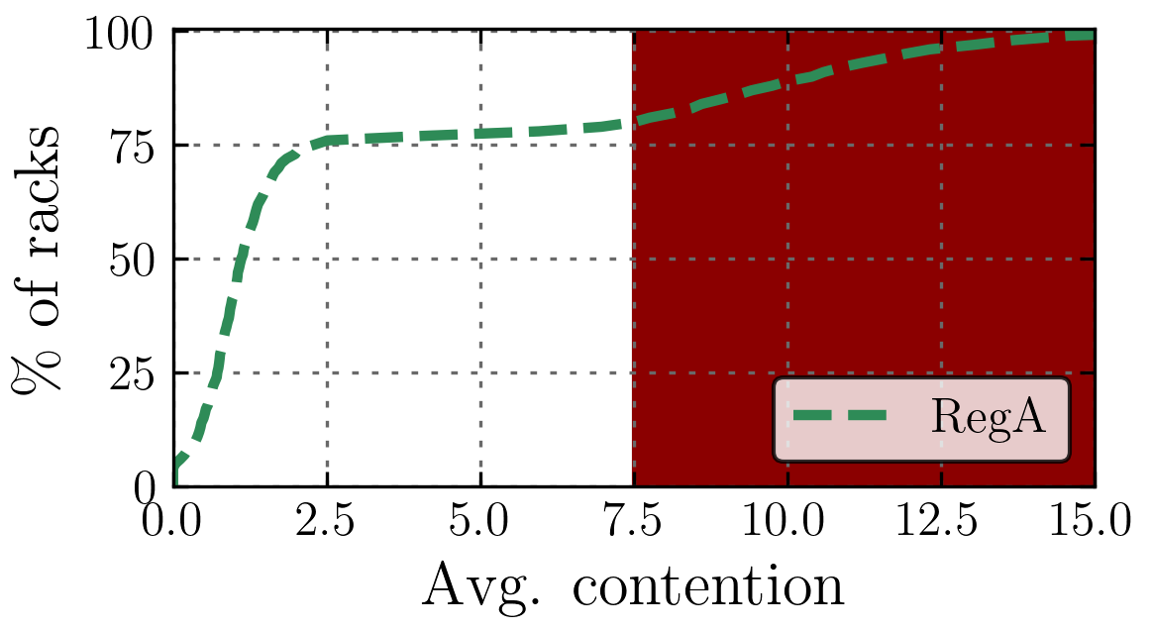
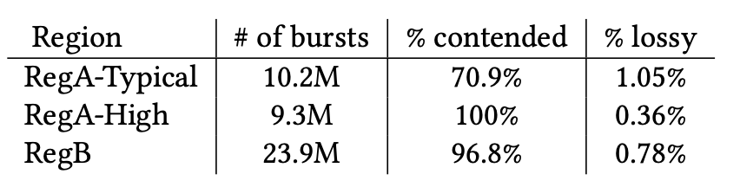
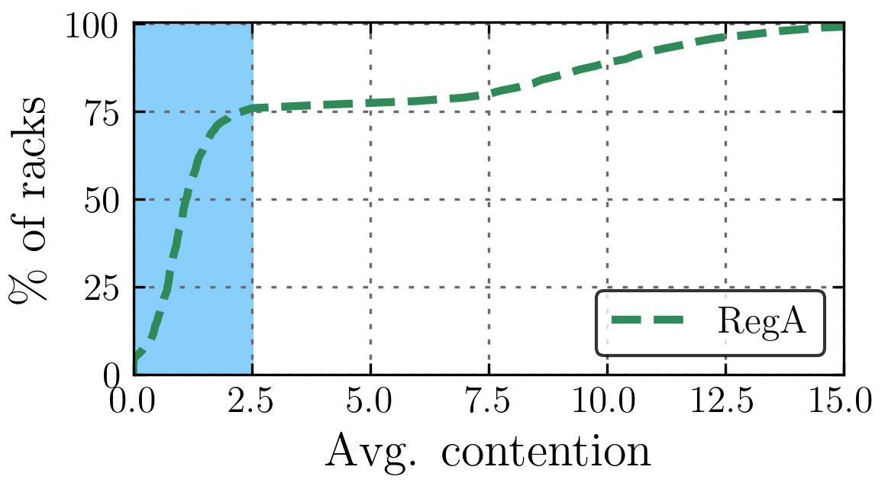
How does contention impact loss?
RegA-Typical
RegA-High
91.4% of bursts are contended.
Surprisingly, bursts in RegA-Typical are experiencing more loss 2.9x higher than RegA-High.

Slide 27
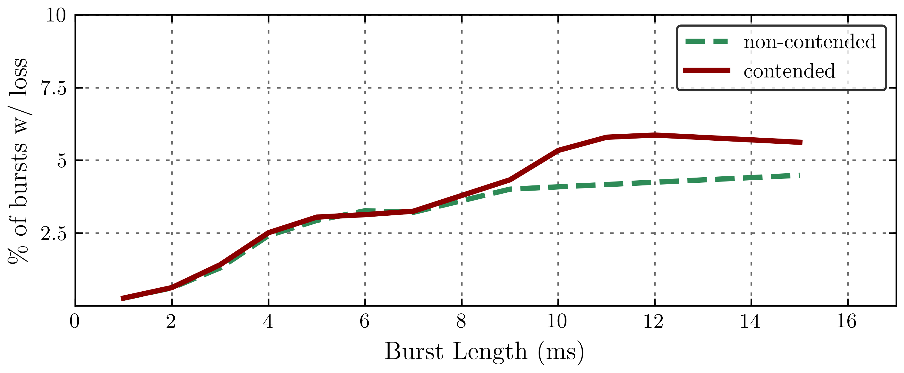
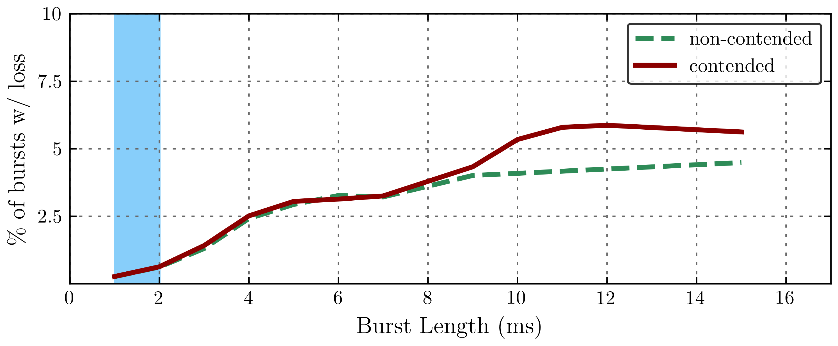
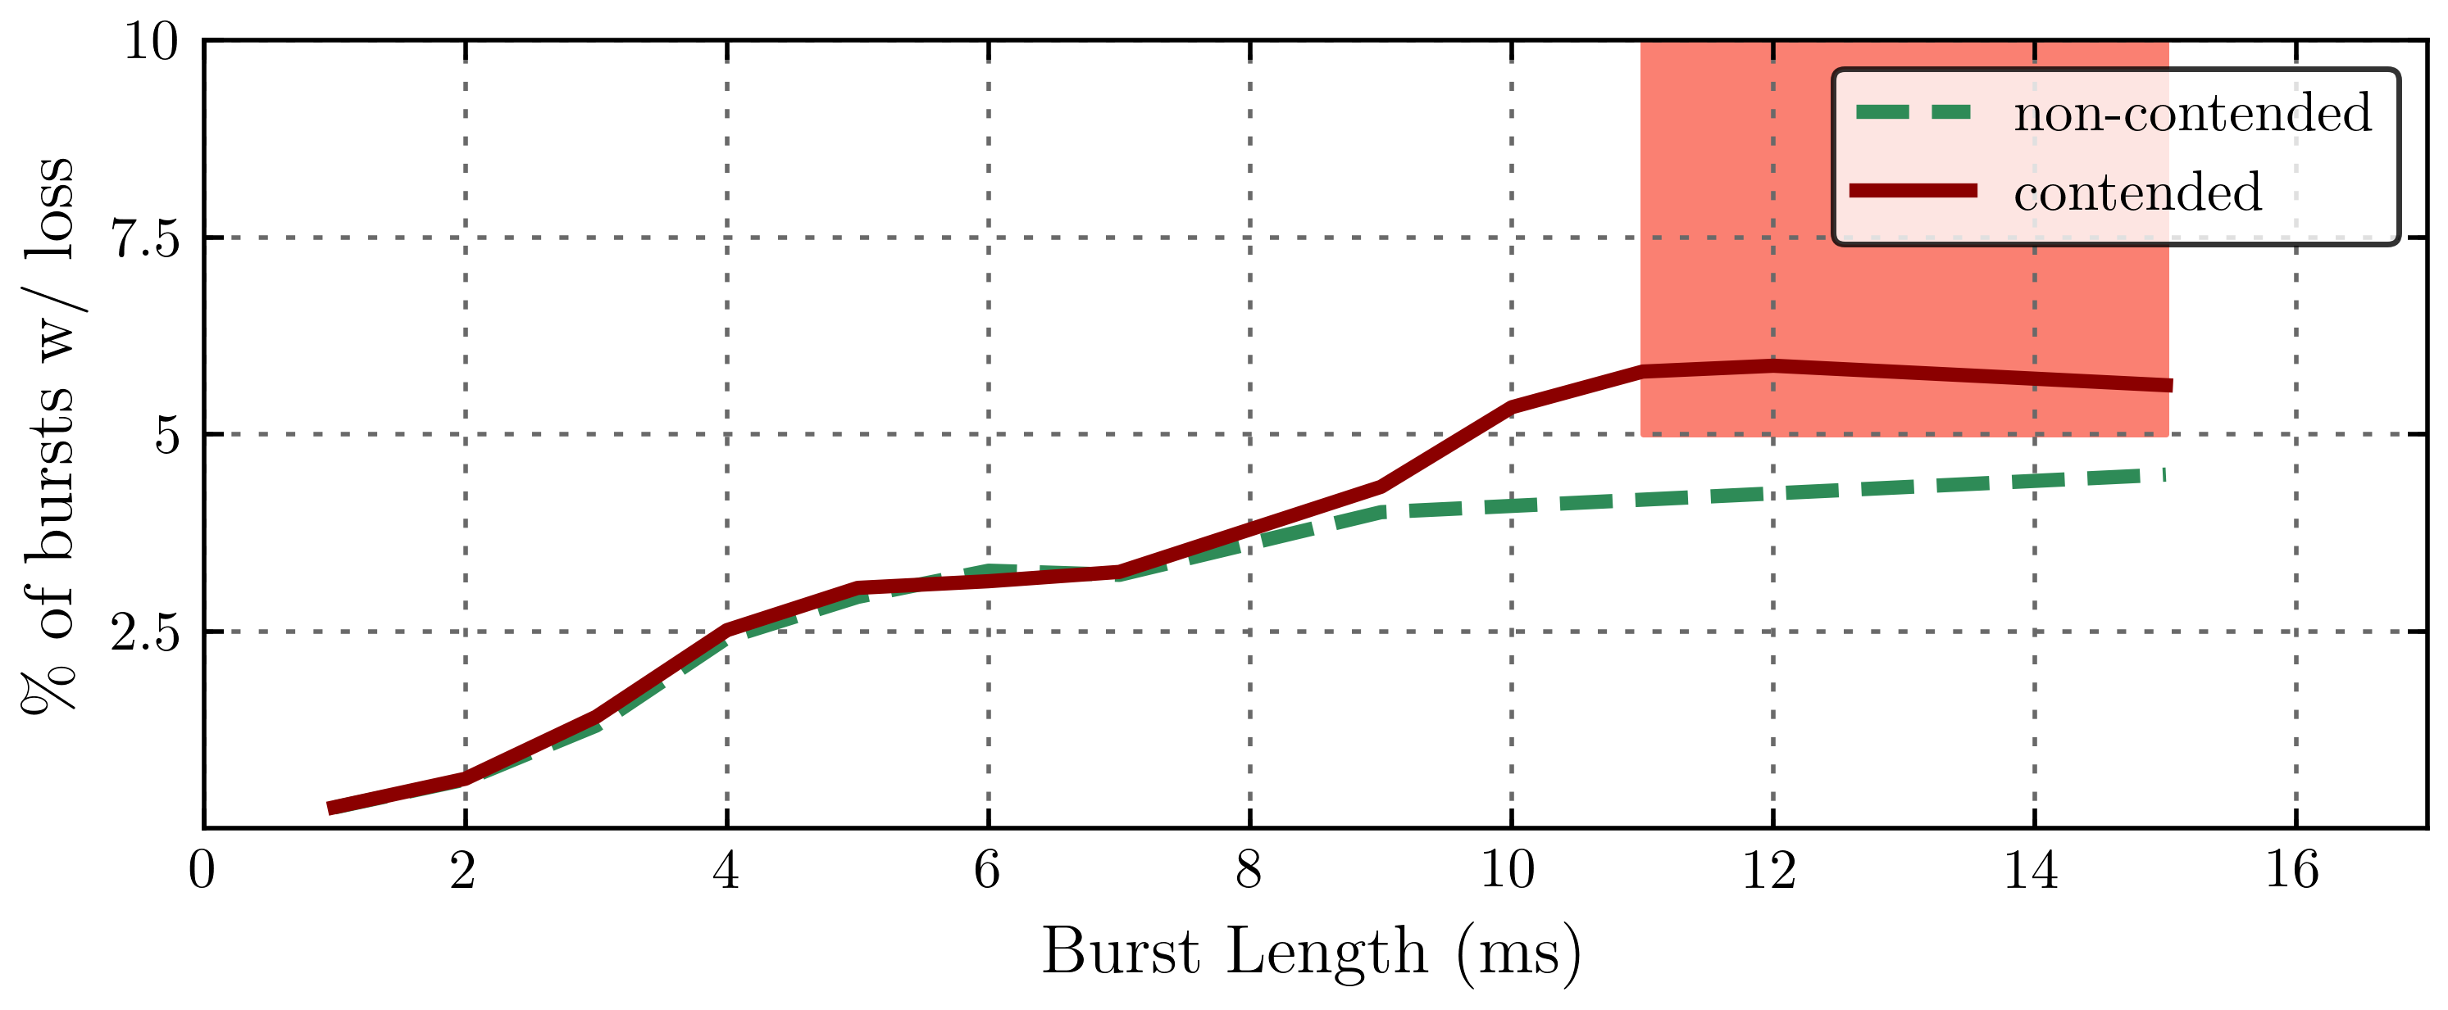
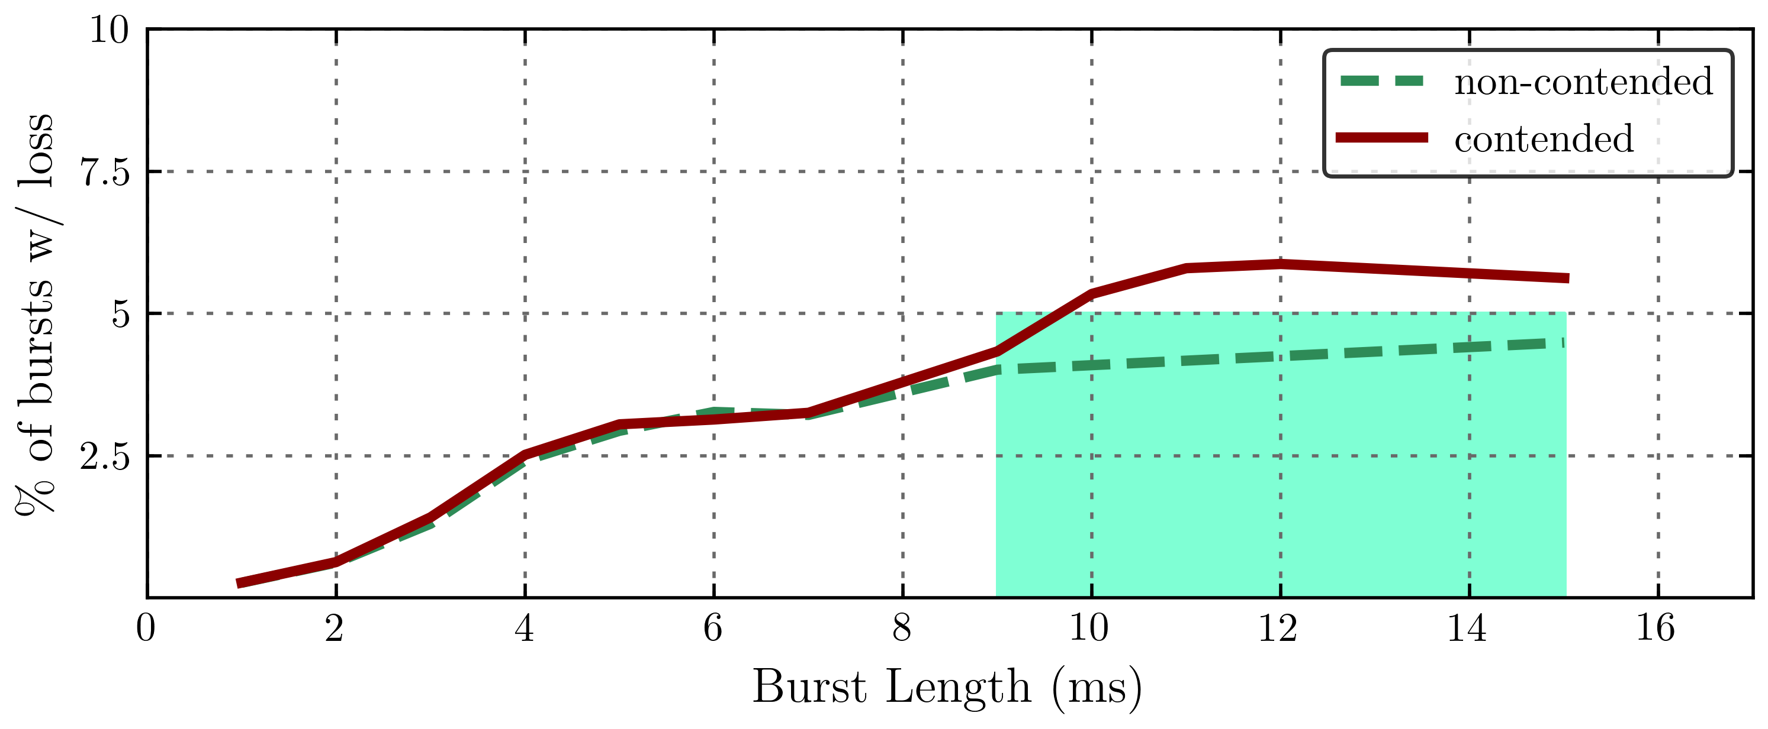
How do burst properties and contention impact loss?
Burst Length
Buffer absorbs short bursts
long bursts Stable loss
contended bursts Higher loss, and takes longer to stabilize

Slide 28
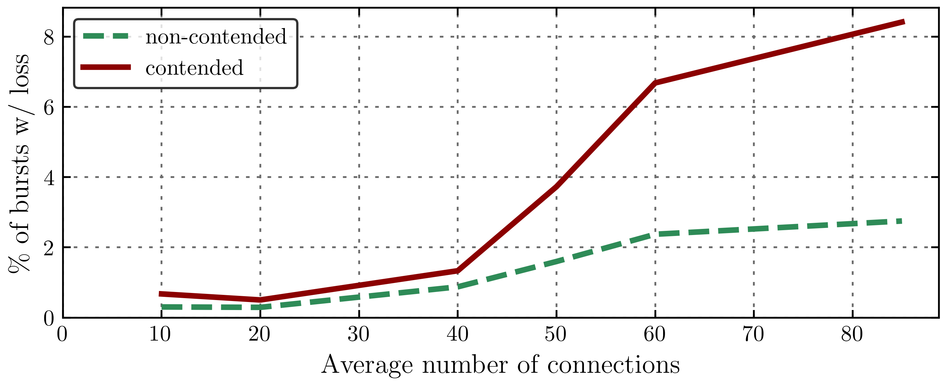
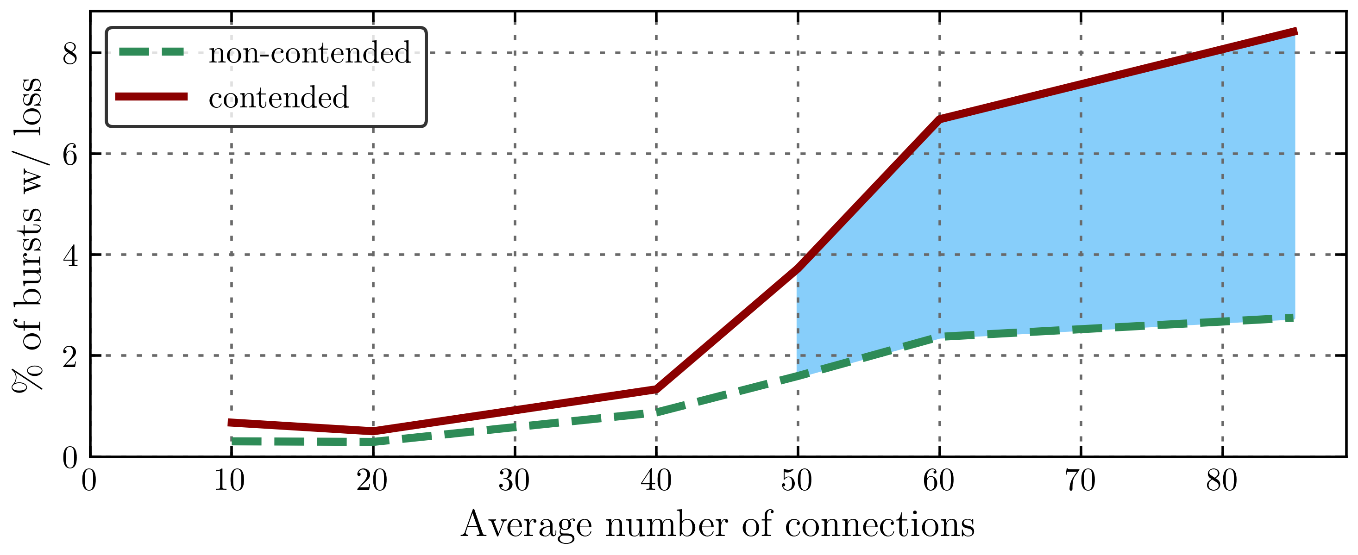
How do burst properties and contention impact loss?
Incast
Contended bursts with heavy incast experience 2-3X of the loss for the not contended.

Slide 29
Conclusion
Millisampler is a lightweight network traffic tool that:
Takes host-centric perspective to data collections
Collect traffic at time-scales of milliseconds
Operationally deployed across all hosts in meta network
Data center scale joint analysis of contention, traffic burstiness, and loss
91.4% Bursts experience contention, and hence variable buffers
Racks average contention follows different distribution and widely varies across racks
Low contended racks experience 2.9X more loss than highly contended ones
15% of runs experience > 70% drop in buffer share
Watch out for the dataset which we will be releasing soon

